Slide 1
Register Allocation

Slide 2
Why Register Allocation?
Storing and accessing variables from registers is much faster than accessing data from memory.
The way operations are performed in load/store (RISC) processors.
Therefore, in the interests of performance—if not by necessity—variables ought to be stored in registers.
For performance reasons, it is useful to store variables as long as possible, once they are loaded into registers.
Registers are bounded in number (say 32.)
Therefore, “register-sharing” is needed over time.

Slide 3
The Goal
Primarily to assign registers to variables.
However, the allocator runs out of registers quite often.
Decide which variables to “flush” out of registers to free them up, so that other variables can be bought in. This important indirect consequence of allocation is referred to as spilling.

Slide 4
Register Allocation and Assignment
Allocation: identifying program values (virtual
registers, live ranges) and program points at which
values should be stored in a physical register.
Program values that are not allocated to registers are
said to be spilled.
Assignment: identifying which physical register
should hold an allocated value at each program point.

Slide 5
Webs
Starting Point: def-use chains
Connects definition to all reachable uses
Conditions for putting defs and uses into same web
Def and all reachable uses must be in same web
All defs that reach same use must be in same web
Use a union-find algorithm
Data structure for partitions
Union: combine two partitions
Find: given an element, find which partition it is in

Slide 6
Example
def y
def x
def y
def x
use y
use x
use y
use x
def x
use x

Slide 7
Example
def y
def x
def y
def x
use y
use x
use y
use x
def x
use x

Slide 8
Example
def y
def x
def y
def x
use y
use x
use y
use x
def x
use x

Slide 9
Example
def y
def x
def y
def x
use y
use x
use y
use x
def x
use x

Slide 10
Example
def y
def x
def y
def x
use y
use x
use y
use x
def x
use x

Slide 11
Example
def y
def x
def y
def x
use y
use x
use y
use x
def x
use x

Slide 12
Example
def y
def x
def y
def x
use y
use x
use y
use x
def x
use x

Slide 13
Example
def y
s1
def x
def y
s2
def x
use y
s3
use x
use y
use x
def x
s4
use x

Slide 14
Webs
Web is unit of register allocation
If web allocated to a given register R
All definitions computed into R
All uses read from R
If web allocated to a memory location M
All definitions computed into M
All uses read from M
Issue: instructions compute only from registers
Reserve some registers to hold memory values

Slide 15
Convex Sets and Live Ranges
Concept of convex set
A set S is convex if
A, B in S and C is on a path from A to B implies C is in S
Concept of live range of a web
Minimal convex set of instructions that includes all defs and uses in web
Intuitively, region in which web’s value is live

Slide 16
Interference
Two webs interfere if their live ranges overlap (have a nonemtpy intersection)
If two webs interfere, values must be stored in different registers or memory locations
If two webs do not interfere, can store values in same register or memory location

Slide 17
Example
def y
s1
def x
def y
s2
def x
use y
s3
use x
use y
use x
def x
s4
use x

Slide 18
Example
Webs s1 and s2 interfere
Webs s2 and s3 interfere
def y
s1
def x
def y
s2
def x
use y
s3
use x
use y
use x
def x
s4
use x

Slide 19
Computing Live Ranges
Using data flow analysis, we compute for each basic
block:
In the forward direction, the reaching attribute.
A variable is reaching block i if a definition or use of the variable reaches the basic block along the edges of the CFG.
In the backward direction, the liveness attribute.
A variable is live at block i if there is a direct reference to the variable at block i or at some block j that succeeds i in the CFG, provided the variable in question is not redefined in the interval between i and j.

Slide 20
Computing Live Ranges (Contd.)
The live range of a variable is the intersection of basic-blocks in CFG nodes in which the variable is live, and the set which it can reach.

Slide 21
Local Register Allocation
Perform register allocation one basic block (or super-block or hyper-block) at a time
Must note virtual registers that are live on entry and live on exit of a basic block - later perform reconciliation
During allocation, spill out all live outs and bring all live ins from memory
Advantage: very fast

Slide 22
Local Register Allocation - Reconciliation Codes
After completing allocation for all blocks, we need to reconcile differences in allocation
If there are spare registers between two basic blocks, replace the spill out and spill in code with register moves

Slide 23
Linear Scan Register Allocation
A simple local allocation algorithm
Assume code is already scheduled
Build a linear ordering of live ranges (also called live intervals or lifetimes)
Scan the live range and assign registers until you run out of them - then spill

Slide 24
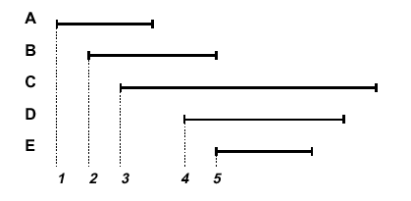
Linear Scan RA
live ranges
sorted
according
to the
start time
of the
first def
scan order
may use same physical register!

Slide 25
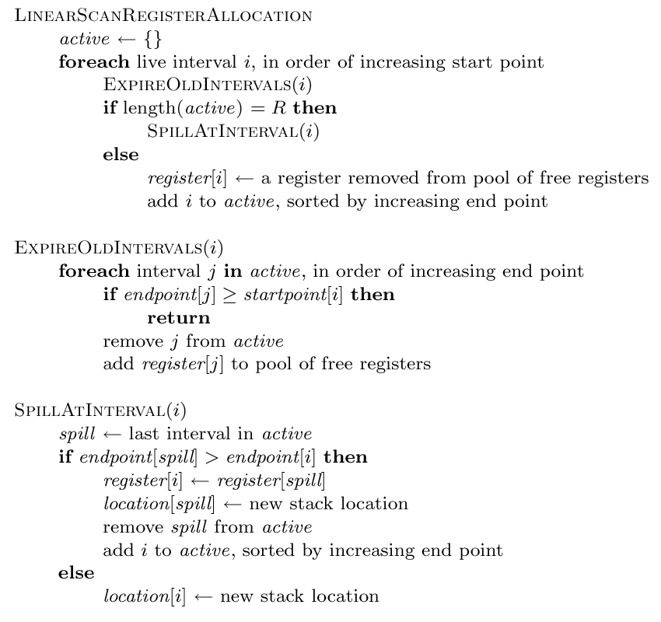
The Linear Scan Algo
Source:
M. Poletto & V. Sarkar.,
“Linear Scan Register Allocation”, ACM TOPLAS, Sep 1999.
actual spill

Slide 26
Global Register Allocation
Local register allocation does not store data in registers across basic blocks.
Local allocation has poor register utilization ⇒ global register allocation is essential.
Simple global register allocation: allocate most “active” values in each inner loop.
Full global register allocation: identify live ranges in control flow graph, allocate live ranges, and split ranges as needed.
Goal: select allocation so as to minimize number of load/store instructions performed by optimized program.

Slide 27
Topological Sorting
Given a directed graph, G = ⟨V, E⟩, we can define a topological ordering of the nodes
Let T = {v₁, v₂, ..., v_{n}} be an enumeration of the nodes of V, T is a topological ordering if v_{i} → v_{j} ∈ E, then i < j (i.e. v_{i} comes before v_{j} in T)
A topological order linearizes a partial order

Slide 28
Global Linear Scan RA
Ignoring back-edges, perform a topological sort of the basic blocks using the CFG
Compute the live range over the entire topological order

Slide 29
Global Live Ranges
Topological Order
B1
B1
B2
B3
B4
A ←
A
B
B2
B3
A ←
B ←
Global Live Ranges
← B
A ←
B4

Slide 30
Simple Example of Global Register Allocation
Control Flow Graph
a =...
B1
T
F
B2
b = ...
..= a
B3
.. = b
B4
Live range of a = {B₁, B₃}
Live range of b = {B₂, B₄}
No interference! a and b can be assigned to the same register

Slide 31
Second Chance Bin-packing
O. Traub, G. Holloway, and M.D. Smith, “Quality and Speed in Linear-Scan Register Allocation”, SIGPLAN ‘98
Considers “holes” in live ranges
Considers register allocation as a bin-packing problem
Performs register allocation and spill code generation at the same time

Slide 32
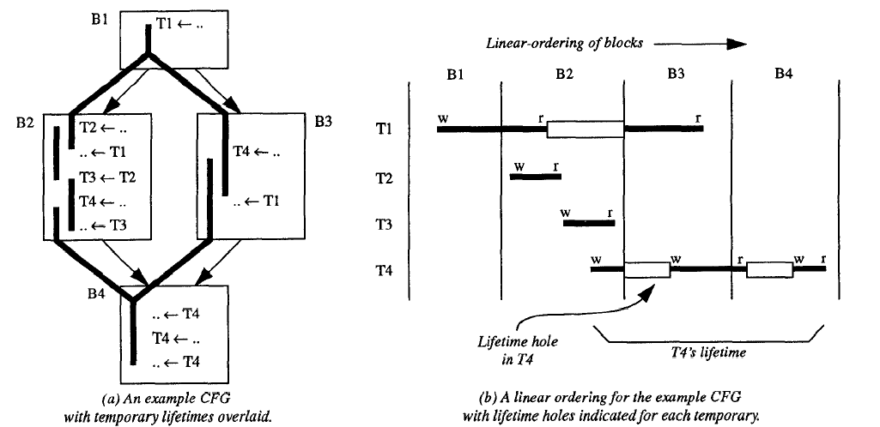
Holes in Live Ranges

Slide 33
Bin-packing
The binpacking problem: determine how to put the most objects in the least number of fixed space bins
More formally, find a partition and assignment of a set of objects such that constraint is satisfied or an objective function is minimized (or maximized)
In register allocation, the constraint is that overlapping live ranges cannot be assigned to the same bin (register)
Another way of looking at linear scan

Slide 34
Working with holes
We can allocate two non-overlapping live ranges to the same physical register
We can assign two live ranges to the same physical register if one fits entirely into the hole of another

Slide 35
Second Chance Linear Scan
Suppose we encounter variable t, and we assigned a register to it by spilling out variable u currently occupying that register
When u is needed again, it may be loaded into a different register (it gets a “second chance”)
It will stay till its lifetime ends or it is evicted again

Slide 36
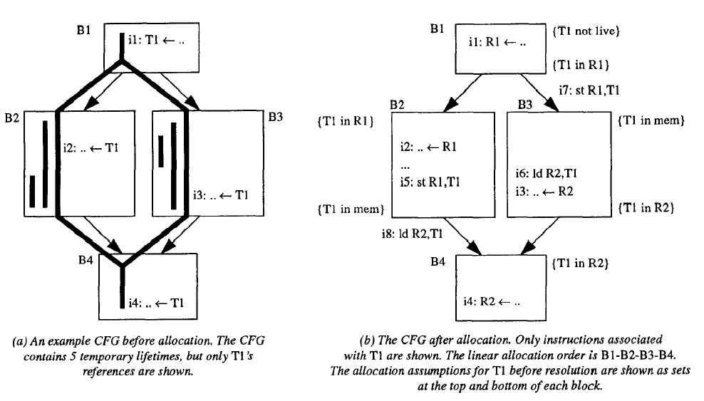
A Problem
resolution code

Slide 37
Register Allocation via Graph Coloring

Slide 38
Interference Graph
Definition: An interference graph G is an undirected
graph with the following properties:
(a) each node x denotes exactly one distinct live range X, and
(b) an edge exists between nodes x and y iff X ∩ Y ≠ ∅, where X and Y are the live ranges corresponding to nodes x and y.

Slide 39
Interference Graph Example
Live Ranges
Interference Graph
a := …
b := …
c := …
:= a
:= b
d := …
:= c
:= d
a
b
c
Node model
live ranges
d
Live ranges overlap
and hence interfere

Slide 40
The Classical Approach
“Register Allocation and Spilling via Graph Coloring”,
G. Chatin, Proceedings SIGPLAN-82 Symposium on
Compiler Construction, 98-105, 1982.
“Register Allocation via Coloring”, G. Chaitin, M.
Auslander, A. Chandra, J. Cocke, M. Hopkins and P.
Markstein, Computer Languages, vol. 6, 47-57, 1981.

Slide 41
The Classical Approach
These works introduced the key notion of an interference graph for encoding conflicts between the live ranges.
This notion was defined for the global control flow graph.
It also introduced the notion of graph coloring to model the idea of register allocation.

Slide 42
Execution Time and Spill-cost
Spilling: Moving a variable that is currently register
resident to memory when no more registers are
available, and a new live-range needs to be allocated
one spill.
Minimizing Execution Cost: Given an optimistic
assigment— i.e., one where all the variables are
register-resident, minimizing spilling.

Slide 43
Graph Coloring
Given an undirected graph G and a set of k distinct colors, compute a coloring of the nodes of the graph i.e., assign a color to each node such that no two adjacent nodes get the same color.
Recall that two nodes are adjacent iff they have an edge between them.
A given graph might not be k-colorable.
In general, it is a computationally hard problem to color a given graph using a given number k of colors.
The register allocation problem uses good heuristics for coloring.

Slide 44
Register Allocation as Coloring
Given k registers, interpret each register as a color.
The graph G is the interference graph of the given program.
The nodes of the interference graph are the executable live ranges on the target platform.
A coloring of the interference graph is an assignment of registers (colors) to live ranges (nodes).
Running out of colors implies not enough registers and hence a need to spill in the above model.

Slide 45
The Chaitin Algorithm
While there exist vertices with < k neighbors in the interference graph, G_{I}
Pick any vertex n such that the degree of n < k and put it on the stack
Remove that vertex and all edges incident to it from G_{I}
This will lower the degree of n’s neighbors
If G_{I} is non-empty (all vertices have k or more neighbors) then:
Pick a vertex n (using some heuristic) and spill the live range associated with n
Remove vertex n from G_{I} , along with all edges incident to it and put it on the stack
If this causes some vertex in G_{I} to have fewer than k neighbors, then go to step 1; otherwise, repeat step 2
Successively pop vertices off the stack and color them in the lowest color not used by some neighbor

Slide 46
Optimistic Coloring
Instead of stopping at the end when all vertices have at least k neighbors, put each on the stack according to some priority
When you pop them off they may still color!

Slide 47
The Chaitin-Briggs Algorithm
While there exist vertices with < k neighbors in G_{I}
Pick any vertex n such that the degree of n < k and put it on the stack
Remove that vertex and all edges incident to it from G_{I}
This will lower the degree of n’s neighbors
If G_{I} is non-empty (all vertices have k or more neighbors) then:
Pick a vertex n (using some heuristic condition), push n on the stack and remove n from G_{I} , along with all edges incident to it
If this causes some vertex in G_{I} to have fewer than k neighbors, then go to step 1; otherwise, repeat step 2
Successively pop vertices off the stack and color them in the lowest color not used by some neighbor
If some vertex cannot be colored, then pick an uncolored vertex to spill, spill it, and restart at step 1

Slide 48
Chow and Hennessy’s Algorithm
“The Priority Based Coloring Approach to Register
Allocation”, F. Chow and J. Hennessy, ACM
Transactions on Programming Languages and
Systems, vol. 12, 501-536, 1990.

Slide 49
Important Modeling Difference
The first difference from the classical approach is that now, we assume that the “home location” of a live range is in memory.
Conceptually, values are always in memory unless promoted to a register; this is also referred to as the pessimistic approach.
In the classical approach, the dual of this model is used where values are always in registers except when spilled; recall that this is referred to as the optimistic approach.

Slide 50
Important Modeling Difference
A second major difference is the granularity at which code is modeled.
In the classical approach, individual instructions are modeled whereas
Now, basic blocks are the primitive units modeled as nodes in live ranges and the interference graph.
The final major difference is the place of the register allocation in the overall compilation process.
In the present approach, the interference graph is considered earlier in the compilation process using intermediate level statements; compiler generated temporaries are known.
In contrast, in the previous work the allocation is done at the level of the machine code.

Slide 51
The Main Information to be Used by the Register Allocator
For each live range, we have a bit vector LIVE of the basic blocks in it.
Also we have INTERFERE which gives for the live range, the set of all other live ranges that interfere with it.
Recall that two live ranges interfere if they intersect in at least one (basic-block).
If ⏐INTERFERE⏐ is smaller than the number of available of registers for a node i, then i is unconstrained; it is constrained otherwise.

Slide 52
The Main Information to be Used by the Register Allocator
An unconstrained node can be safely assigned a register since conflicting live ranges do not use up the available registers.
We associate a (possibly empty) set FORBIDDEN with each live range that represents the set of colors that have already been assigned to the members of its INTERFERENCE set.
The above representation is essentially a detailed
interference graph representation.

Slide 53
Prioritizing Live Ranges
In the memory bound approach, given live ranges with
a choice of assigning registers, we do the following:
Choose a live range that is “likely” to yield greater savings in execution time.
This means that we need to estimate the savings of each basic block in a live range.

Slide 54
Estimate the Savings
Given a live range X for variable x, the estimated
savings in a basic block i is determined as follows:
1. First compute CyclesSaved which is the number of loads and stored of x in i scaled by the number of cycles taken for each load/store.
2. Compensate the single load and/or store that might be needed to bring the variable in and/or store the variable at the end and denote it by Setup.
Note that Setup is derived from a single load or store or a load plus a store.

Slide 55
Estimate the Savings (Contd.)
3. Savings(X,i) = {CyclesSaved-Setup}
These indicate the actual savings in cycles after accounting for the possible loads/stores needed to move x at the beginning/end of i.
4. TotalSavings(X) = Σ_{iεX} Savings(X,i) x W( i ).
(a) x is the set of all basic blocks in the live range of
X.
(b) W( i ) is the execution frequency of variable x in
block i.

Slide 56
Estimate the Savings (Contd.)
5. Note however that live regions might span a few
blocks but yield a large savings due to frequent use of the variable while others might yield the same cumulative gain over a larger number of basic blocks. We prioritize the former case and define:
{Priority(X) = TotalSavings(X)/Span(X)}
where Span(X) is the number of basic blocks in X.

Slide 57
The Algorithm
For all constrained live ranges, execute the following steps:
1. Compute Priority(X) if it has not already been computed.
2. For the live range X with the highest priority:
(a) If its priority is negative or if no basic block i in X can be assigned a register—because every

Slide 58
The Algorithm
color has been assigned to a basic block that
interferes with i — then delete X from the list and
modify the interference graph.
(b) Else, assign it a color that is not in its forbidden
set.
(c) Update the forbidden sets of the members of
INTERFERE for X’.

Slide 59
The Algorithm (Contd.)
3. For each live range X’ that is in INTERFERE for X’ do:
(a) If the FORBIDDEN of X’ is the set of all colors
i.e., if no colors are available, SPLIT (X’).
Procedure SPLIT breaks a live range into smaller
live ranges with the intent of reducing the
interference of X’ it will be described next.
4. Repeat the above steps till all constrained live
ranges are colored or till there is no color left to
color any basic block.

Slide 60
The Idea Behind Splitting
Splitting ensures that we break a live range up into increasingly smaller live ranges.
The limit is of course when we are down to the size of a single basic block.
The intuition is that we start out with coarse-grained interference graphs with few nodes.
This makes the interference node degree possibly high.
We increase the problem size via splitting on a need-to basis.
This strategy lowers the interference.

Slide 61
The Splitting Strategy
A sketch of an algorithm for splitting:
1. Choose a split point.
Note that we are guaranteed that X has at least one basic block i which can be assigned a color i.e., its forbidden set does not include all the colors. The earliest such in the order of control flow can be the split point.
2. Separate the live range X into X₁ and X₂ around the split point.
3. Update the sets INTERFERE for X₁ and X₂ and those for the live ranges that interfered with X

Slide 62
The Splitting Strategy
4. Recompute priorities and reprioritize the list.
Other bookkeeping activities to realize a safe
implementation are also executed.

Slide 63
Live Range Splitting Example
a :=
b :=
BB1
a
c :=
BB2
b
c
interference graph
BB3
BB4
:= a
:= b
BB5
Live Ranges:
a: BB1, BB2, BB3, BB4, BB5
b: BB1, BB2, BB3, BB4, BB5, BB6
c: BB2, BB3, BB4, BB5
Assume the number of physical registers = 2
:= b
BB6

Slide 64
Live Range Splitting Example
a
a :=
b :=
…
spill introduced
BB1
b
c
c :=
BB2
split b
T
F
b2
BB3
BB4
interference graph
New live ranges:
a: BB1, BB2, BB3, BB4, BB5
b: BB1
c: BB2, BB3, BB4, BB5
b2: BB6
b and b2 are logically the same program variable
b2 is a renamed equivalent of b.
All nodes are now unconstrained.
:= a
:= b
BB5
…
:= b
BB6

Slide 65
Optimal register allocation for SSA form

Slide 66
The good news
Register allocation in general is NP-complete
BUT
the register allocation problem for a uniform register set is solvable in polynomial time for SSA-form programs

Slide 67
Source
S. Hack and G. Goos, “Optimal register allocation for SSA-form programs in polynomial time”. Information Processing Letters, 2006.

Slide 68
SSA-form (recap)
A CFG is in SSA-form if any use of a variable is reachable by exactly one definition of that variable
CFG in SSA-form requires the introduction of the φ function to merge control flows.

Slide 69
Some preliminaries
We abstract an instruction by the following form:
l: (d₁, …, d_{m}) ← τ(u₁, …, u_{n})
l is the (unique) label of the instruction
τ is the opcode (Op_{l})
d₁, …, d_{m} are the variables defined by the instruction (Res_{l})
u₁, …, u_{n} are the variables used by the instruction (Arg_{l} - let Arg_{l}(i) be the i-th argument of the instruction)

Slide 70
Labels
Each label has an ordered set of k predecessor labels denoted by
We write l’ →^{i} l if l’ =
If we don’t care about position and just want to say that l’ is a predecessor of l then we write l’ → l

Slide 71
Our good friend the dominator
l dominates l’ if every path from START to l’ contains l
We write l  l’
Note that l  l

Slide 72
φ and φ’
If at the start of a basic block, we have a series of φ, i.e.
y₁ = φ(x₁₁, …, x_{1n})
…
y_{m} = φ(x_{m1}, …, x_{mn})
then we use a more concise φ’-notation
l : (y₁, …, y_{m}) = φ’(x₁₁, …, x_{1n} , …, x_{m1}, …, x_{mn})
that sets y_{i} = x_{ij} if l was reached via

Slide 73

Arg’
It is convenient to define
i.e., all operands of a φ’-function reached via

Slide 74
Traditional liveness
Traditional definition:
A variable v is live at a label l, if there is a path from l to a use of v not containing a definition of v
Does not work because of φ

Slide 75
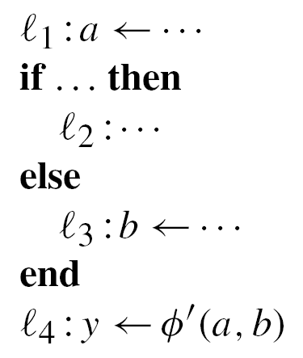
The problem with standard liveness
a is not live in l₃, although there is a path from l₃ to the use of a in l₄

Slide 76
USE in SSA
usage(i, l, v) = TRUE if Op_{l} ≠ φ’ and v ∈ Arg_{l}
or if Op_{l} = φ’ and v ∈ Arg’_{l}(i)
In addition to label and variable, we now also need to consider the predecessor by which the label was reached (as represented by the integer)

Slide 77
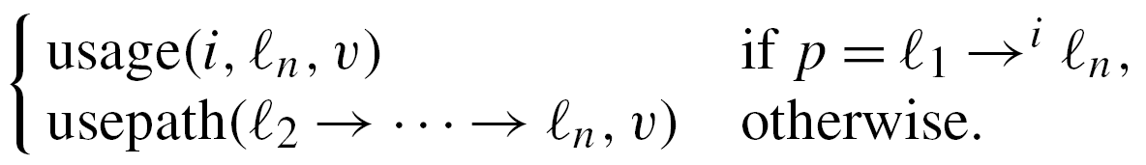
Usepath
Usepath is a Boolean function defined as follows:
usepath(p:l₁→ …→ l_{n}, v) =

Slide 78
The problem with standard liveness
l₁, l₂ , l₄ is a usepath of a
l₁, l₃ , l₄ is a usepath of b

Slide 79
Liveness in SSA
Let D_{v} denotes the label in which variable v is defined, i.e., D_{v} = l if v ∈ Res_{l}.
A variable v is live at a label l₁ if and only if there exists a label l_{n} with usepath(l₁ → l₂ → … → l_{n}, v) and D_{v} ∉ {l₂, …, l_{n}}.

Slide 80
Strict Program
A program is called strict if and only if for each value v, each path from START to some label l with usepath(START→… → l, v) contains the definition of v.

Slide 81
Important lemma
In a strict program, each label l at which a value v is live is dominated by D_{v}.

Slide 82
Some more facts about SSA
Corollary: Each value v, used in a non-φ’-operation at a label l is dominated by its definition
Corollary: If a value v ∈ Arg’_{l}(i) for a φ’-operation at a label l and some i, then the definition of v dominates
Corollary: Let l be a label with Op_{l} ≠ φ’. Each pair of values v, w ∈ Arg_{l} interfere.

Slide 83
In other words
φ’-operations do not cause interferences
As far as liveness is concerned, φ’-operations can be treated as if they have no arguments
φ’-operations extend the lifetimes of their arguments to the end of the respective predecessor label

Slide 84
Back to some graph theory
With the above definitions of liveness (and interference) in SSA-form, we can construct the interference graph
It turns out the interference graph has some special properties making coloring it simpler

Slide 85
Induced subgraph
A graph is complete if for every pair of nodes, there is an edge
G’ is an induced subgraph of G if V_{G’} ⊆ V_{G} and for all nodes, v, w ∈ V_{G’} such that (v, w)∈ E_{G} implies (v, w)∈ E_{G’}
Note: G is undirected, i.e. if (v, w)∈ E_{G} then (w, v)∈ E_{G}

Slide 86
Simplicial vertex
A vertex v is simplicial, if v and its neighbours induce a complete subgraph in G. This subgraph is also called a clique.
Simplicial vertex

Slide 87
Perfect Elimination Order (PEO)
A linearly ordered sequence of vertices, v₁, …, v_{n} is a perfect elimination order, if each v_{i} is simplicial in the subgraph induced by {v_{i}, …, v_{n}} in G.
The class of graphs for which PEO exists is called chordal or triangulated graphs.

Slide 88
Chordal graphs
A graph is chordal if each of its cycles of four or more nodes has a chord, which is an edge joining two nodes that are not adjacent in the cycle.
chords

Slide 89
Properties of SSA-form interference graphs
If two values v and w are live at some label l, then either D_{v}  D_{w} or D_{w}  D_{v}
If v and w interfere and D_{v}  D_{w} , then v is live at D_{w}
Suppose a interferes with b, and b interferes with c, but a does not interfere with c. If D_{a}  D_{b} , then D_{b}  D_{c}

Slide 90
SSA and PEO
A value v can extend a PEO, if each value whose definition is dominated by D_{v} is already contained in the PEO

Slide 91
The key theorem
The interference graph of a SSA-form program P is chordal.
Why is this important?
Any chordal graph can be colored in polynomial time.

Slide 92
Maximal Cardinality Search
Input: a undirected graph G = (V, E)
Output: a sequence of vertices s[i]∈V, i = 1 to |V|
For all v ∈ V, initialize weight(v) = 0
V’ = V
For i = 1 to |V| do
begin
s[i] = v where ∀u ∈ V’ weight(v) ≥ weight(u)
for all u ∈ V’ such that (u, v) ∈ E do
begin
weight(u)++
end
V’ = V’ – {v}
end
O(|V|+|E|)

Slide 93
Greedy coloring
Input: a undirected graph G = (V, E), a sequence of vertices s[i] obtained from maximal cardinality search, and an ordered sequence of colours c[j]
Output: a color assignment m[v] to all vertices
For i = 1 to |V| do
begin
v = s[i]
let c be the lowest colour not used by any neighbours of v
m[v] = c
end

Slide 94
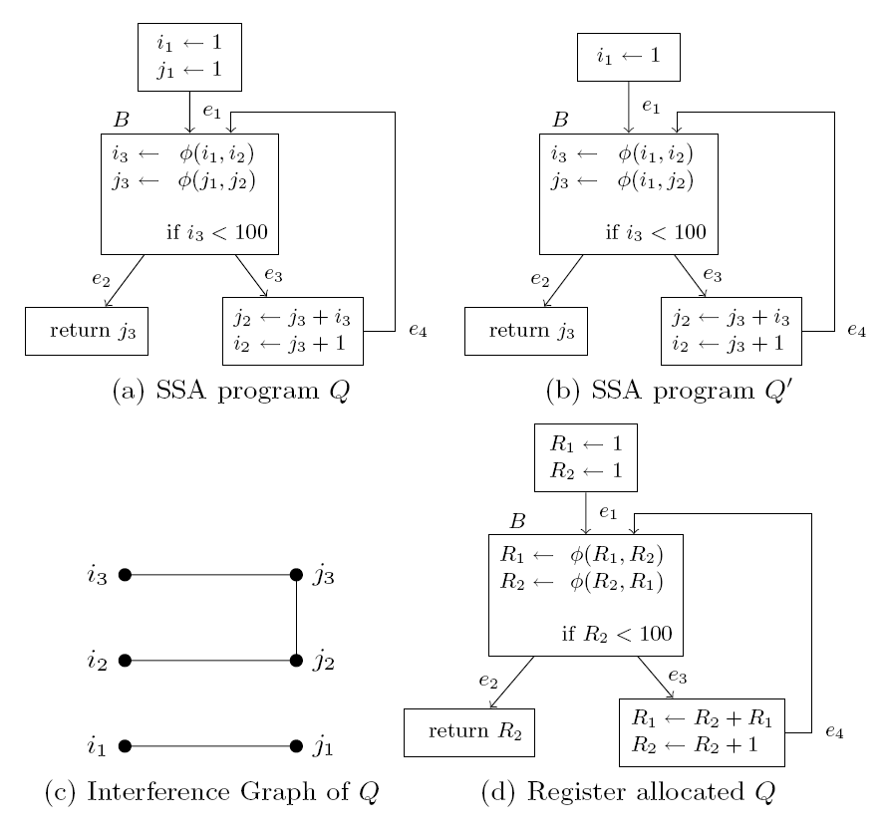
An Example

Slide 95
Two hiccups
Spilling (because you only have that many registers)
Leaving SSA form

Slide 96
Spilling
You can apply any heuristics you want to split live ranges
Only trouble is that splitting a live range results in a program no longer in SSA-form
Have to redo SSA conversion

Slide 97
Leaving SSA-form
No real processor implements SSA-form
Have to convert out of SSA-form
How to preserve the register allocation?

Slide 98
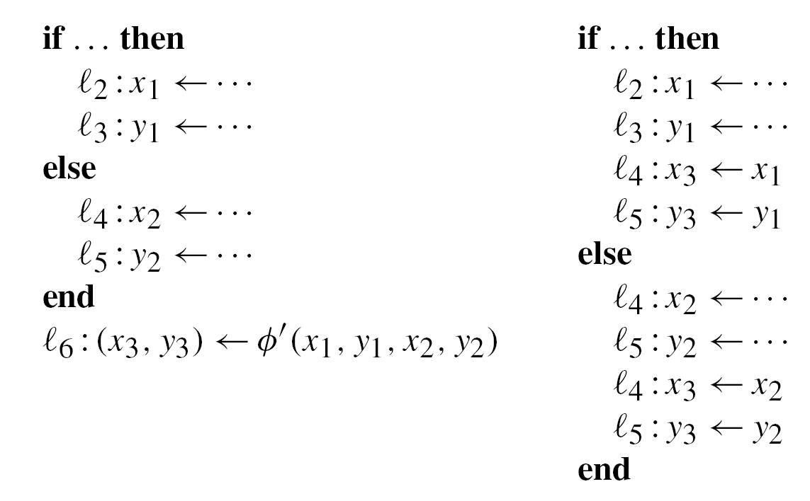
Leaving SSA-form thru copy
All values already allocated to registers.
So it is a matter of copying/swapping registers.

Slide 99
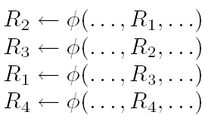

Some tricks
Why?
Can be achieved by:

Slide 100
Some tricks
No action needed.
Can be achieved by:

Slide 101
Some tricks
R₃
R₂
Can be achieved by:

Slide 102
Some tricks
R₃
R₂
Can be achieved by:

Slide 103
End

